Slide 1
Human Resources Dataset Analytics
By Team (2)
Hisham Ghaly
Ahmed Sabry
Esraa Nagy
Karim Youssef

Slide 2
TABLE OF CONTENT
Introduction
Project Objective
Data Cleaning
Data Modeling
Dax Calculations
Analysis Scope
Recommendations
Key Insights
Conclusion

Slide 3
INTRODUCTION
This presentation outlines the analysis of a human resources dataset, focusing on employee management, performance tracking, and workforce planning.
The dataset comprises five tables: Employee, Performance Rating, Education Level, Rating Level, and Satisfaction Level.

Slide 4
PROJECT OBJECTIVE
The objective of this project is to analyze the HR process, identify inefficiencies, and propose solutions to improve operational efficiency. By examining key HR functions such as recruitment, onboarding, performance management, and employee engagement, we aim to uncover areas of improvement.
Additionally, the project seeks to identify the key drivers of employee satisfaction and performance through data-driven insights. These insights will help the organization optimize its HR strategies, improve employee retention and productivity, and ensure that HR processes are aligned with business goals for long-term success.

Slide 5
DATA CLEANING
Date fields (HireDate and ReviewDate) standardized to DD/MM/YYYY.
Renaming columns (e.g., changing Education to EducationLevelID).
Mapping values (e.g., changing Stock option Level codes 0-3 to meaningful labels: "None," "Low," "Medium," and "High").
State abbreviations mapped to full names (e.g., IL to Illinois, CA to California).
Replacing one word of “Marketing” instead of 2 instances.

Slide 6
DATA MODELING
Data Relationship Setup
The tables are related through primary and foreign keys.
EmployeeID connects the Employee & Performance Rating tables.
SatisfactionID, RelationshipSatisfaction , EnvironmentSatisfaction & JobSatisfaction connects Performance Rating & Satisfied Level tables
RatingID , SelfRating, & ManagerRating connects Performance Rating & Rating Level tables
EducationLevelID connects the Employee & Education Level tables

Slide 7
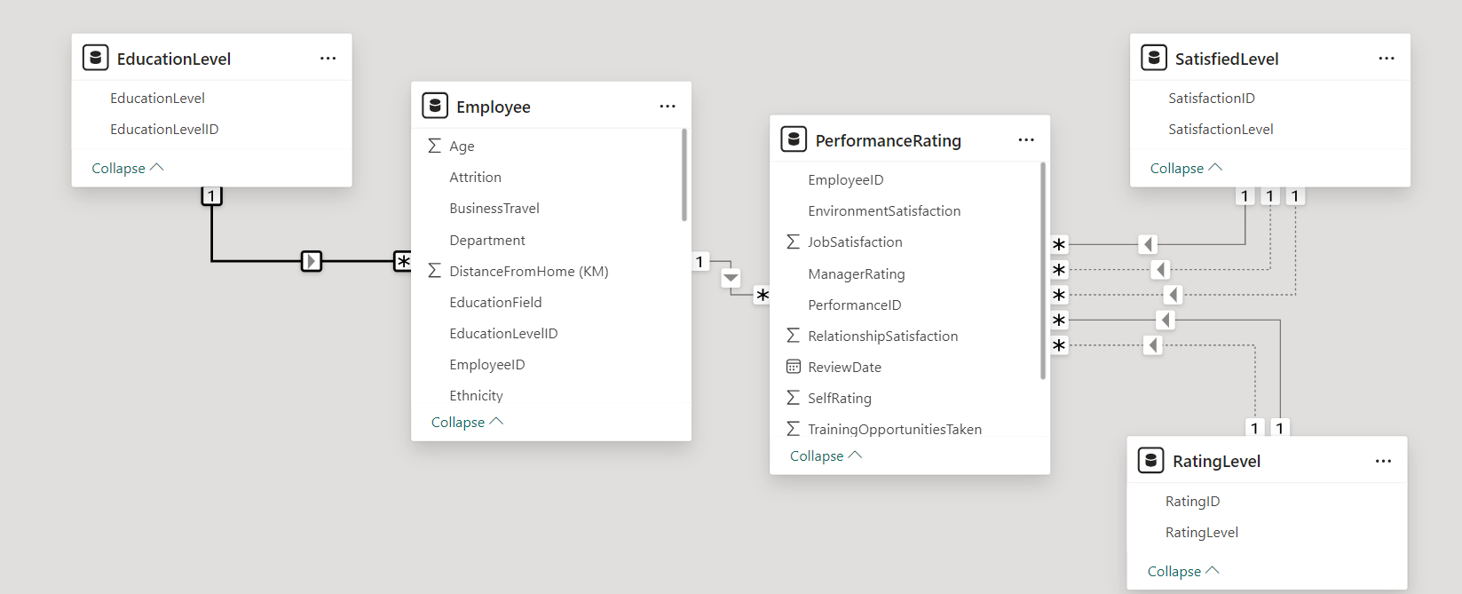

Slide 8
DAX CALCULATIONS
Years at Company: DAX function calculates the number of years an employee has been at the company.
Attrition Rate: DAX calculation for the proportion of employees who have left.
Retention Rate: DAX calculation for the proportion of employees still with the company.
RelationshipSatisfactionMeasure: DAX calculation for the count of performance ratings based on a specific relationship between satisfaction levels and relationship satisfaction within the dataset.
SelfRatingMeasure: DAX calculation for the count of performance ratings based on a specific relationship between rating levels and self-rating within the dataset.
WorkLifeBalanceLabel: DAX formula to translate the numeric work-life balance ratings into descriptive text labels.

Slide 9
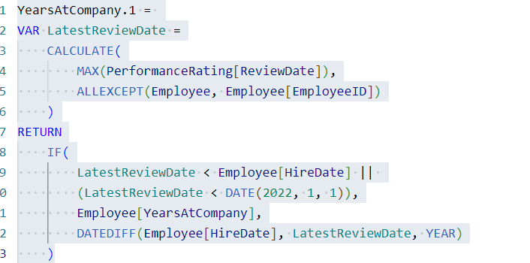
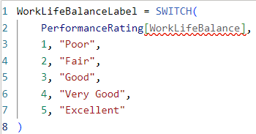


Slide 10
ANALYSIS SCOPE
Understand the factors that contribute to employee turnover.
Analyze the workforce diversity based on gender, ethnicity, and other factors.
Assess the impact of work-life balance factors (e.g., business travel, distance from home) on employee satisfaction and retention.
Analyze employee tenure and stability within the company.
Examine salary structure, stock options, and their impact on employee satisfaction and retention.
Explore the role of managers in employee retention and satisfaction.
Investigate relationships between multiple factors to identify patterns.

Slide 11
KPIS | Description
Headcount | Total number of employees
Onboard | Number of current employees
Exits | Number of employees who have left
Retention % | Overall workforce stability
Attrition % | The rate at which employees leave the organization

Slide 12
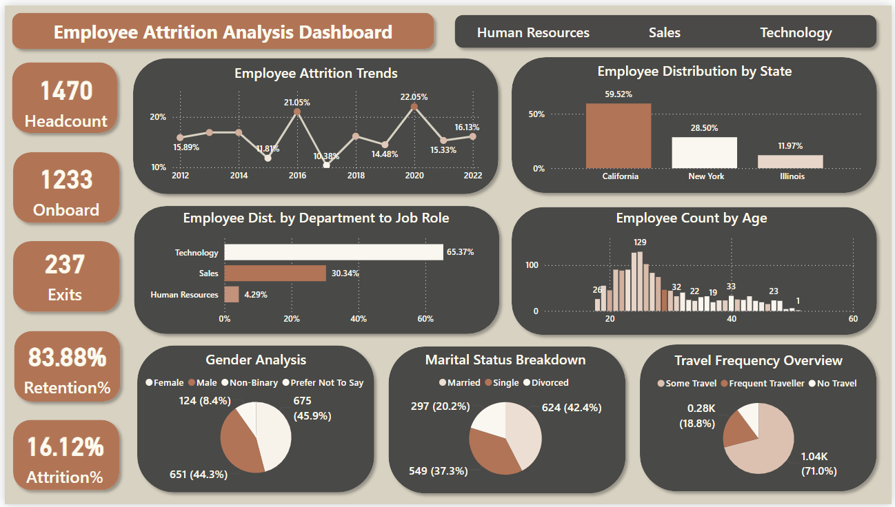

Slide 13
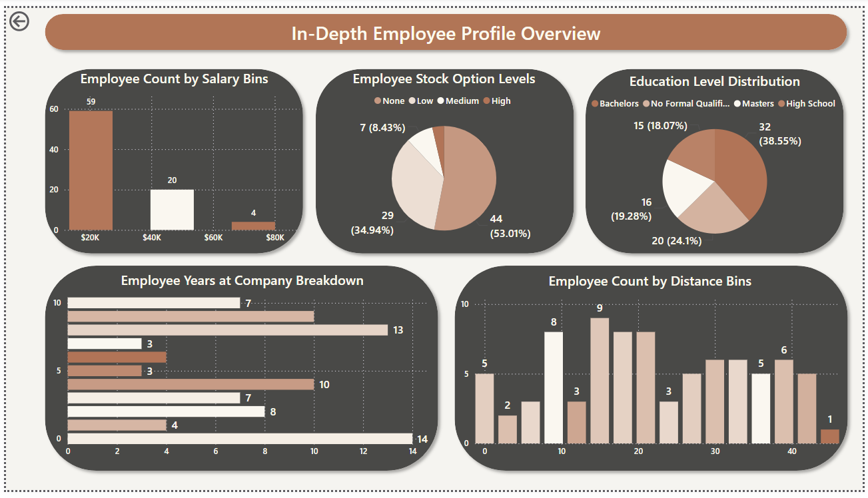

Slide 14
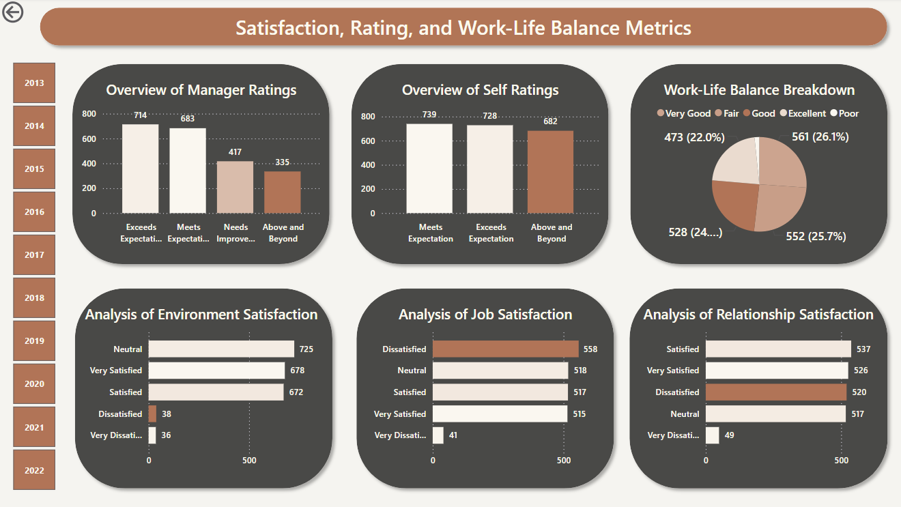

Slide 15
KEY INSIGHTS
The current attrition rate is 16.12%, with the highest turnover recorded in 2020.
Most employees are in California 59.52% from total employees , which also has the highest turnover rate among state 17.49% .
Although the Technology department has the largest number of employees, the Sales team has the highest attrition rate at 20.63%, specifically among Sales Representatives.
Single employees have the highest attrition rate, which is reasonable considering their younger age demographic.
Employees who travel frequently exhibit the highest attrition rate compared to other travel categories.
Employees with none stock option level show the highest attrition.
Dissatisfaction in workplace relationships leads to the highest attrition rate.

Slide 16
CONCLUSION
Based on the insights from the employee attrition analysis dashboards
The organization is experiencing a relatively high attrition rate, particularly in certain departments and among specific employee groups.
Several factors are influencing employee turnover, including low manager ratings, job dissatisfaction, workplace relationship issues, long commutes, and compensation levels.
To effectively address attrition, the organization should implement targeted strategies to improve manager effectiveness, enhance job satisfaction, foster a positive workplace culture, address commuting challenges, and ensure fair compensation.
Regular monitoring and analysis of employee attrition data are crucial for identifying emerging trends and evaluating the effectiveness of implemented strategies.

Slide 17
RECOMMENDATIONS
Invest in training programs to improve managerial skills and create a more supportive work environment.
Implement initiatives to boost job satisfaction and employee engagement, such as recognition programs, career development opportunities, and flexible work arrangements.
Foster a positive and inclusive workplace culture that promotes collaboration, communication, and respect.
Explore options to reduce the impact of long commutes, such as flexible work arrangements, transportation benefits, or relocating offices to more accessible locations.
Conduct a thorough review of compensation levels and ensure that employees are fairly rewarded for their contributions.
By implementing these recommendations, the organization can significantly reduce employee attrition and create a more positive and productive work environment.

Slide 18
THANK YOU.

